Slide 1
Data Science YouTube channels Video Metadata
Anson Hsu, Aidan Nguyen, Ryan Wong, James Baguley

Slide 2
Agenda
1: Project Goal
2. Data Description
3: Data clean-up/preparation
4: EDA/preparation
5. Comprehensive Information Approach
6: Thumbnail-based Approach
7. Text-based Approach

Slide 3
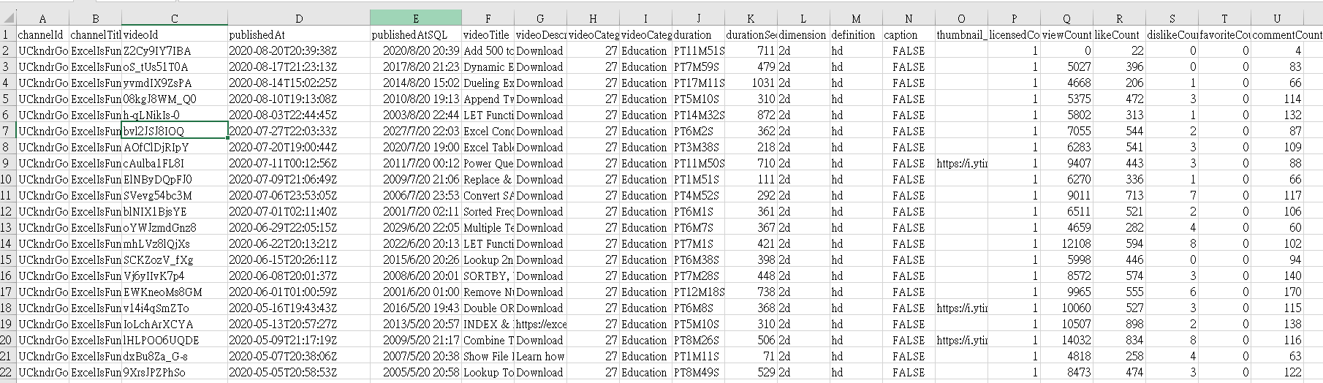
Project Goal
1. Comprehensive Information Approach:
Incorporates general video details, including like count, dislike count, video category, and publish time, etc.
Aims to quantify the superior predictive performance compared to thumbnail and text-based methods.

Slide 4
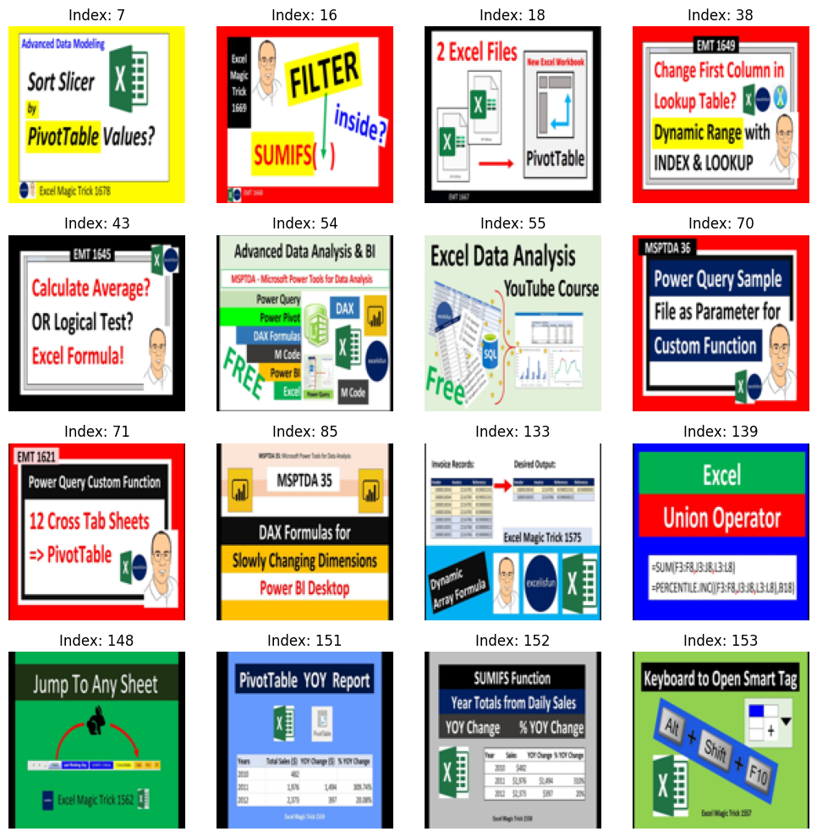
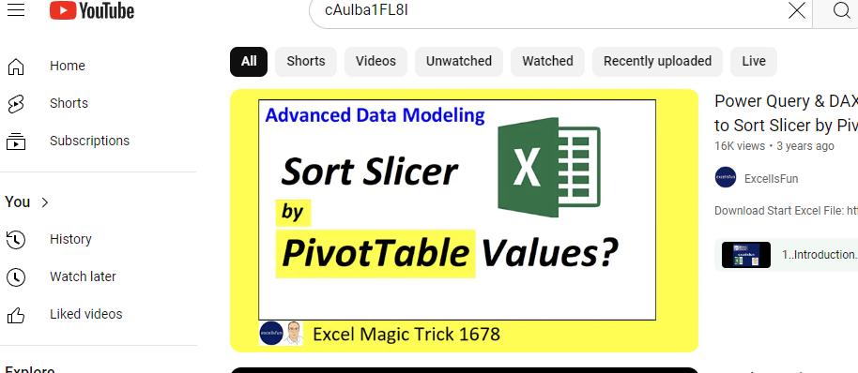
Project Goal
2. Thumbnail-based Approach:
Utilizes thumbnail images to
predict YouTube video view
counts.
Investigates the visual
elements' impact on viewer
engagement.

Slide 5
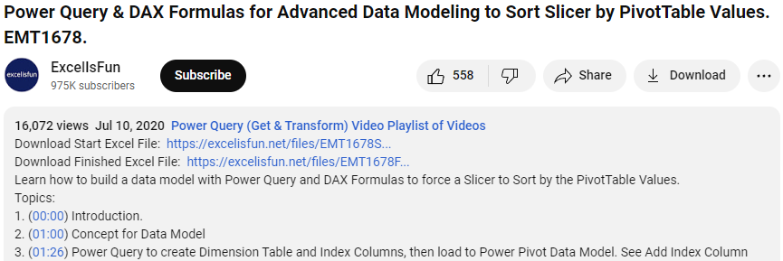
Project Goal
3. Text-based Approach:
Extracts insights from video titles and descriptions to forecast view counts.
Evaluates the significance of textual content in predicting viewer interest.

Slide 6
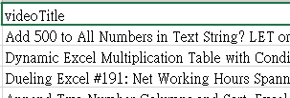
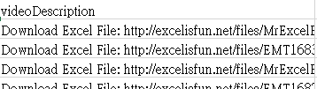
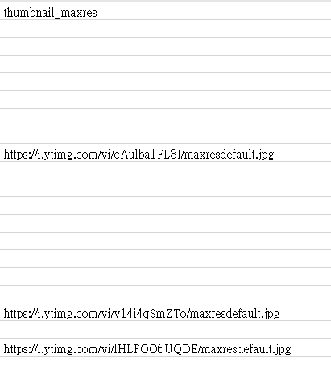
Data Description
Video Title and Description
Since comparing 3 approach, and there is missing value on thumbnail.
Extracted 34192/44261 = 77.25% of data has thumbnail links
Numerical Feature: durationSec, likeCount, dislikeCount, commentCount, days_since_published, sin_hour, cos_hour
Categorical Feature: channelTitle, videoCategoryLabel, definition, caption, licensedContent, comment_error, like_dislike_error ,daysOfWeek, month, year
Thumbernail_maxres

Slide 7
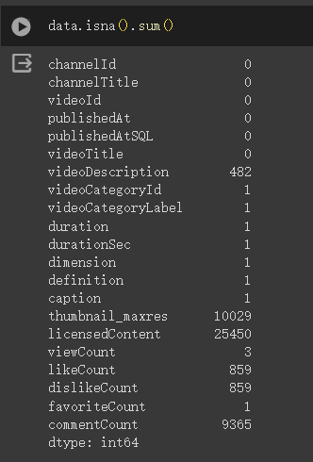
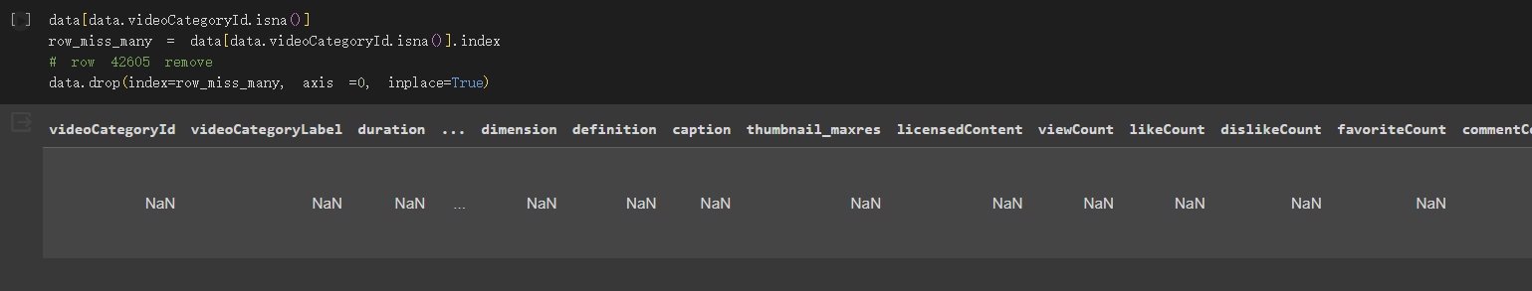
Data clean-up/Preparation
Missing data
Those have only 1 missing
Those missing value are all happen in this row.
Just drop the this row, it won’t caused.

Slide 8
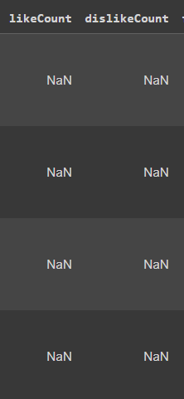
Data clean-up/Preparation
Missing data
b) Like count and Dislike count
Like and dislike’’s missing value will only happen simultaneously.

Slide 9
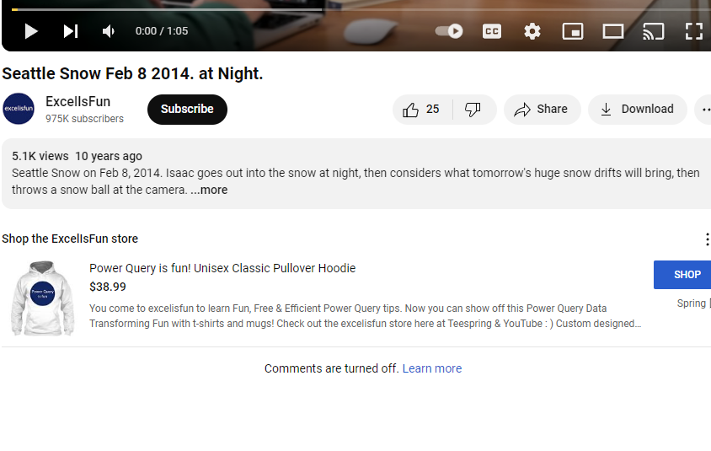
Data clean-up/Preparation
Missing data
c) Comment count

Slide 10
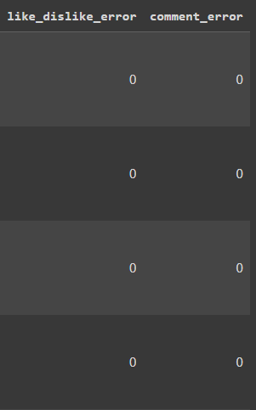
Data clean-up/Preparation
Missing data
c) Like count, dislike count, Comment count
Solution:
Filled the -1 for missing value in Like count, dislike count, Comment count.
Create the 2 new columns:
0: There is the value
1: There is the error

Slide 11
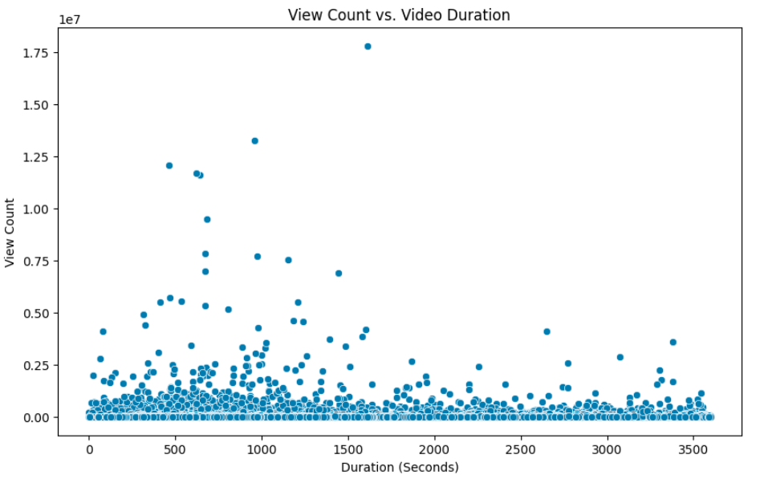
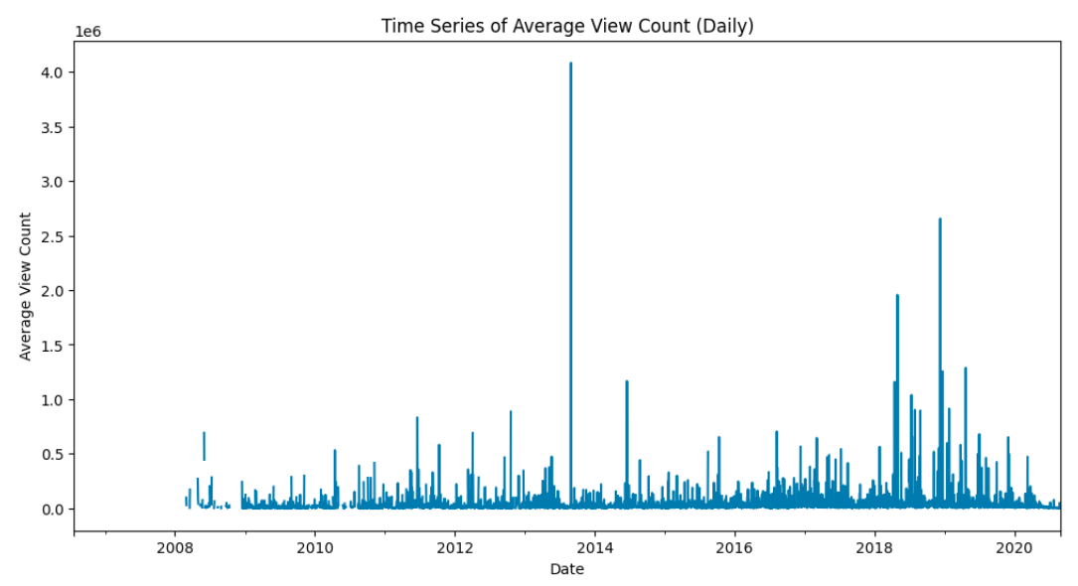
EDA

Slide 12
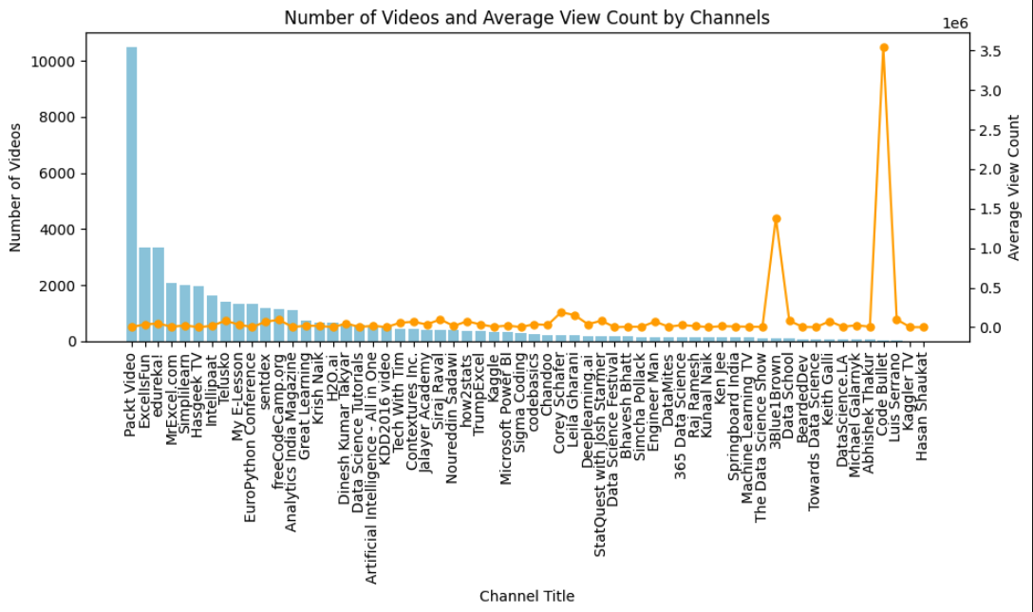

Slide 13
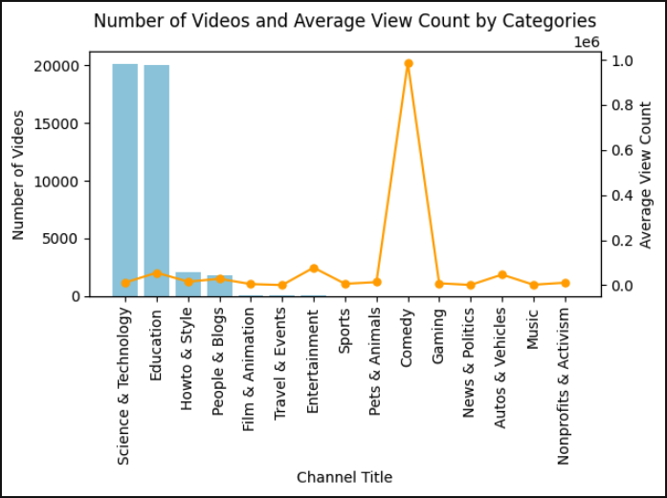

Slide 14
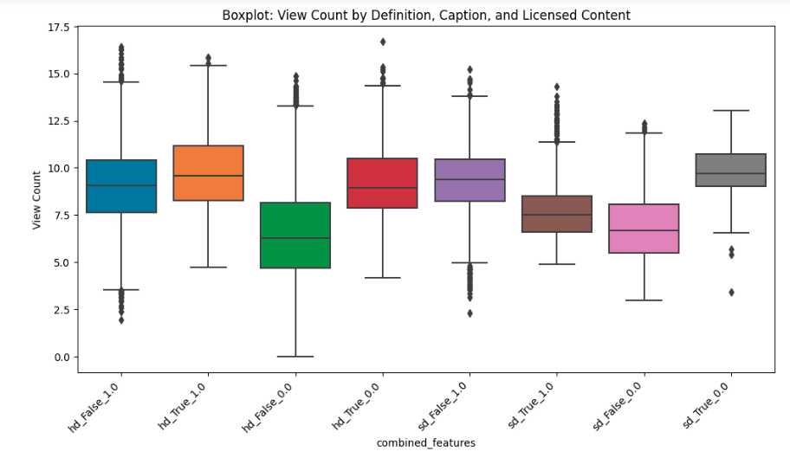

Slide 15
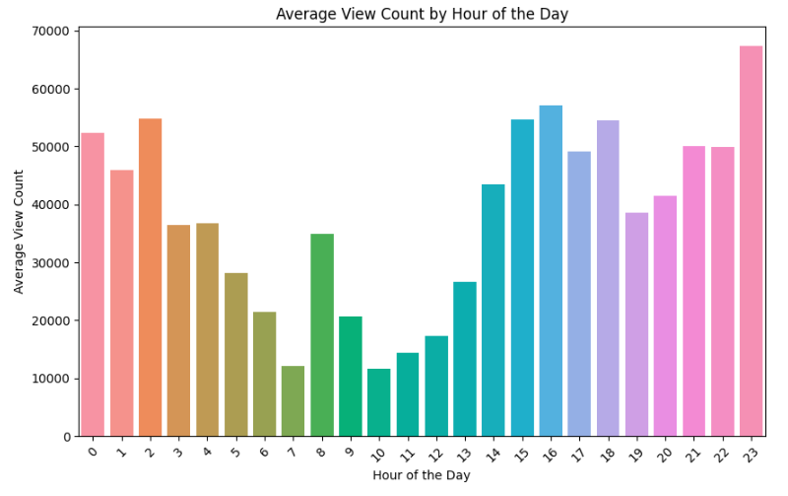

Slide 16
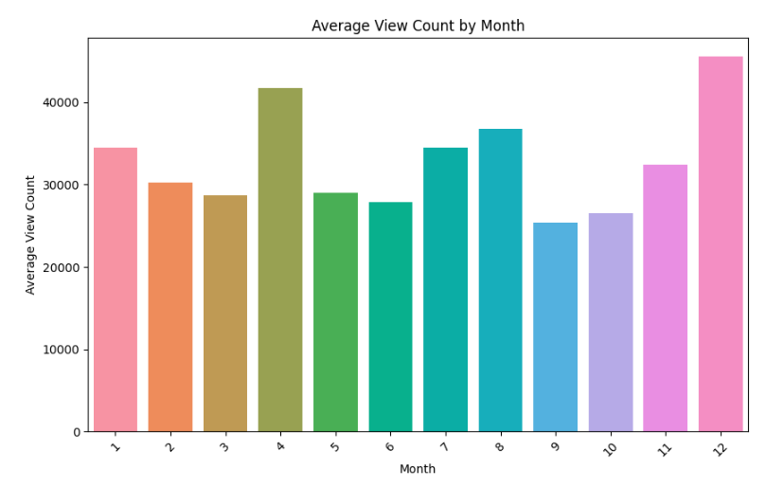

Slide 17
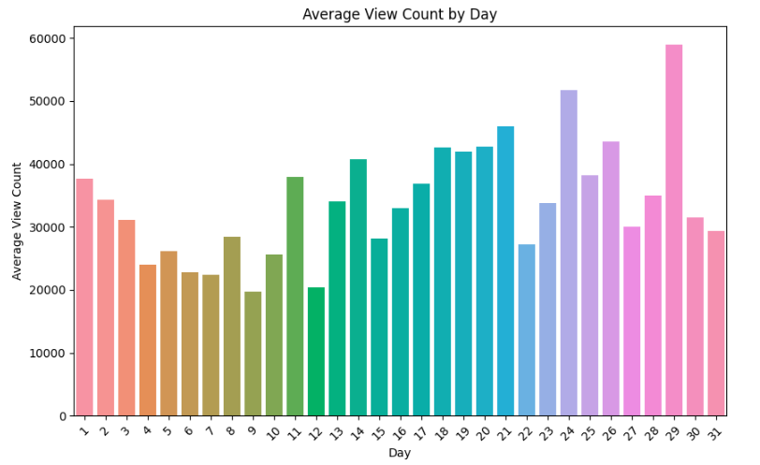

Slide 18
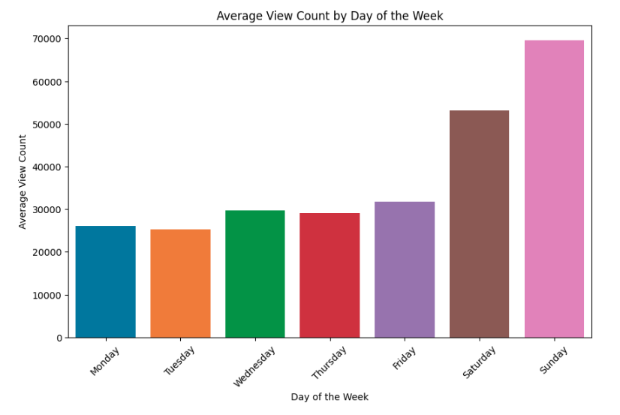

Slide 19
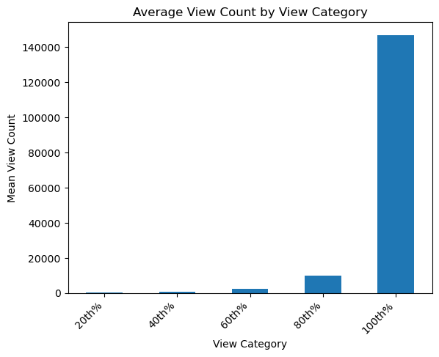

Slide 20
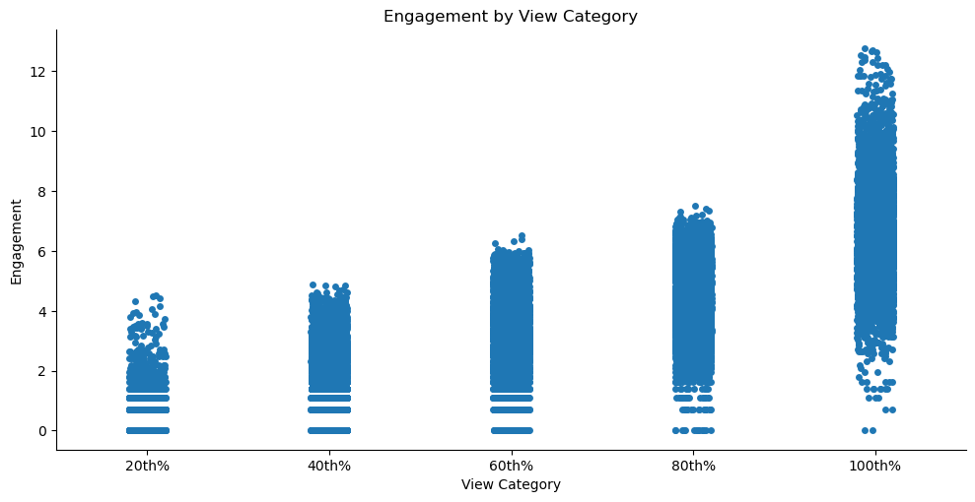

Slide 21
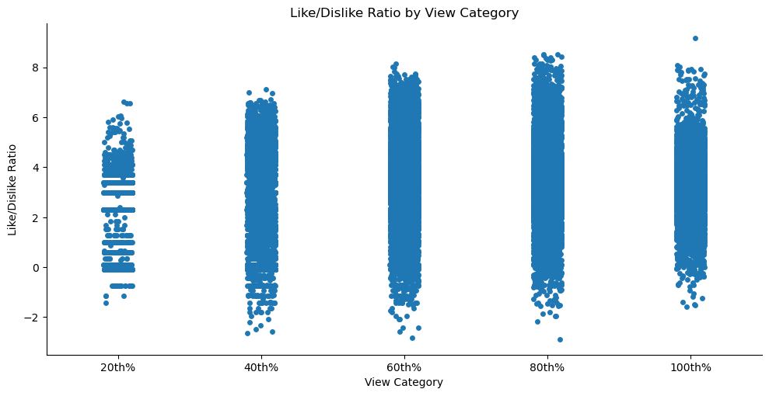

Slide 22
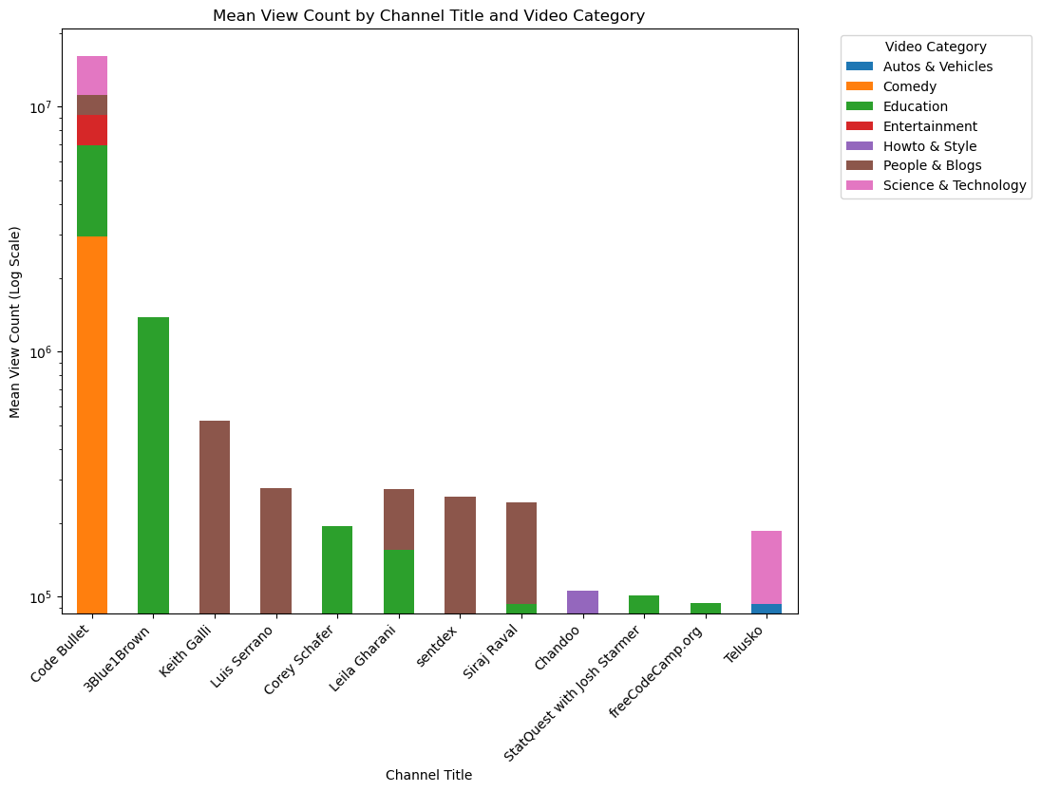

Slide 23
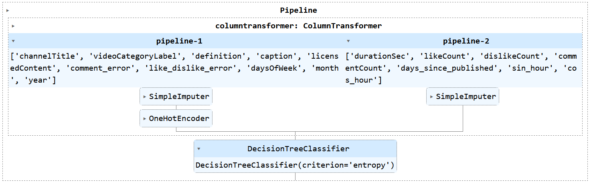
Comprehensive Approach:
Decision Tree
Pipeline: Split numerical/categorical columns before applying SimpleImputer and OneHotEncoder.

Slide 24
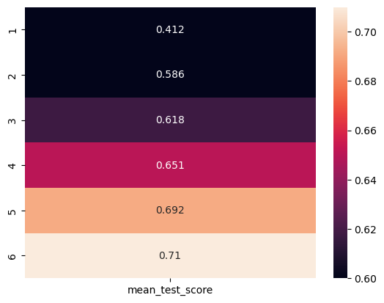
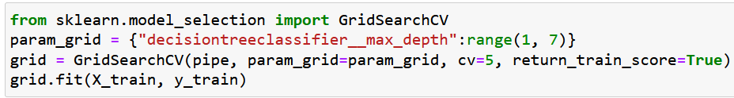
Comprehensive Approach:
Decision Tree
Gridsearch CV applied to find best Depth for the decision tree

Slide 25
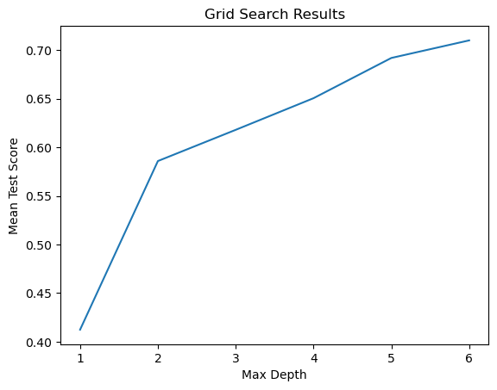
Comprehensive Approach:
Decision Tree
71% accuracy on test set at depth 6
Similarity of scores implies good fit

Slide 26
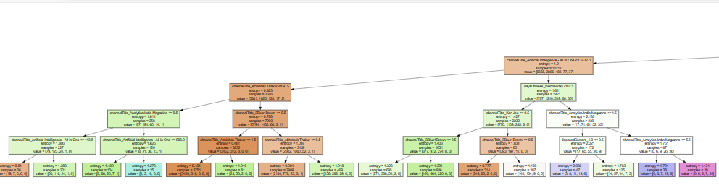
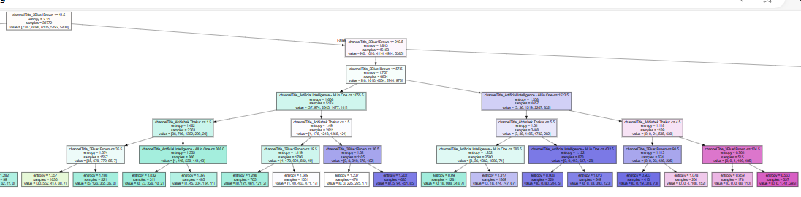
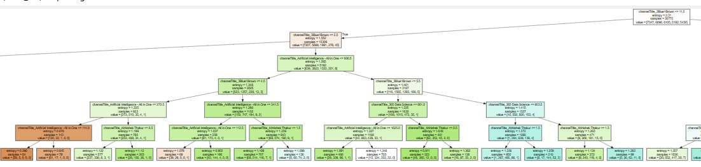
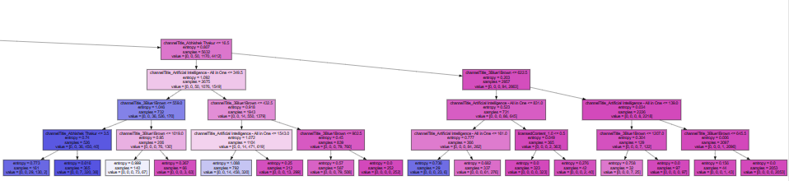
Comprehensive Approach:
Decision Tree

Slide 27
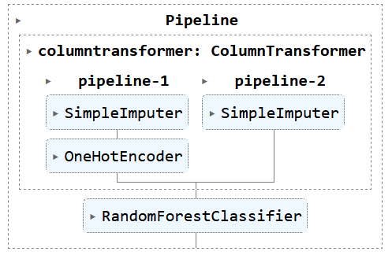
Comprehensive Approach:
Random Forest
Same Preprocessing steps as Decision Tree, apply SimpleImputer to all columns and OneHotEncoder to Categorical Columns before applying Random Forest

Slide 28
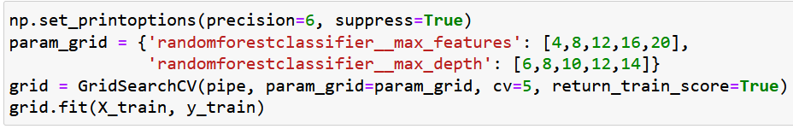
Comprehensive Approach:
Random Forest
Set max features and depth and apply GridsearchCV to pipeline to find best parameters.

Slide 29
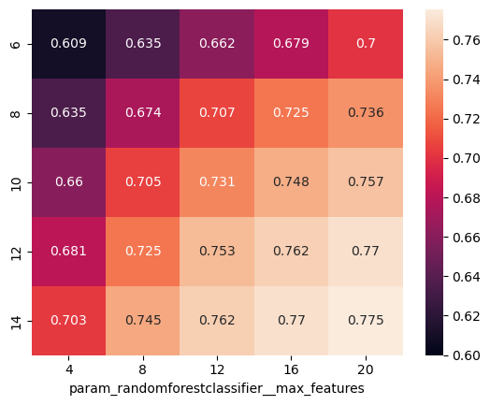
Comprehensive Approach:
Random Forest
77% accuracy on test set is greater than the 71% accuracy on the decision tree
Training set scores higher than test set but not significantly enough to be overfitted

Slide 30
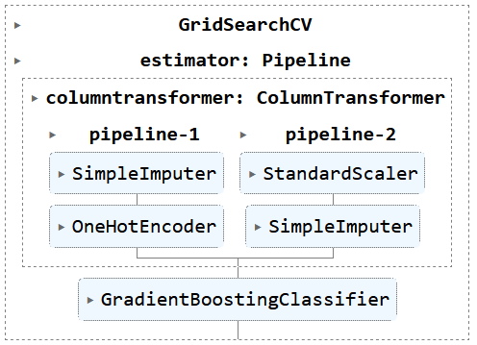
Comprehensive Approach:
Boosting
Pipeline now incorporates standard scaler on numerical values before applying Gradient Boosting

Slide 31
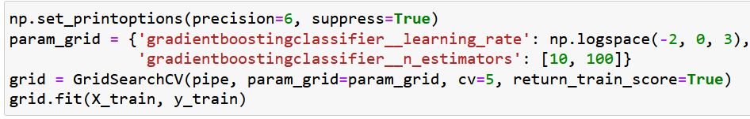
Comprehensive Approach:
Boosting
Apply GridSearchCV to determine the optimal learning rate and number of estimators.

Slide 32
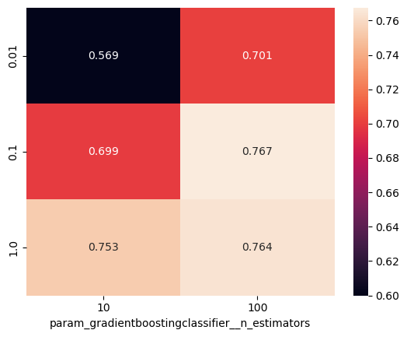
Comprehensive Approach:
Boosting
Test score is similar to the test score of the Random Forest model
Higher similarity to the training score implies this is better fitted than the Random Forest model

Slide 33
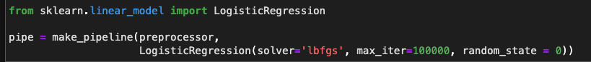
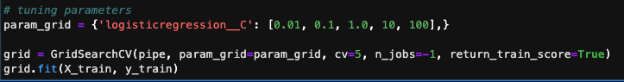
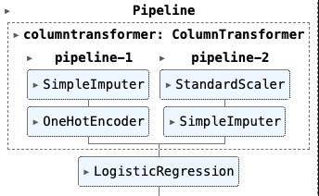
Logistic Regression
Same preprocessor
Do Grid Search CV to choose the best parameter for C

Slide 34
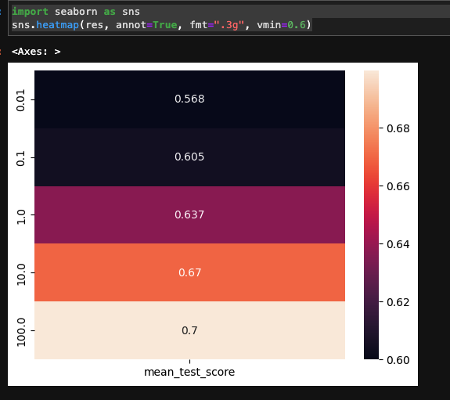
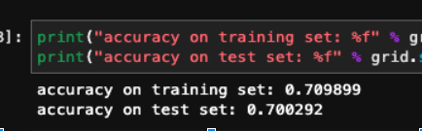
Logistic Regression
Accuracy is 0.700292
Best parameter for C is 100

Slide 35
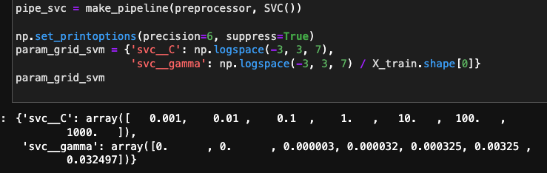
Kernelized SVM
Same preprocessor
Do Grid Search CV to choose the best parameters for C & gamma

Slide 36
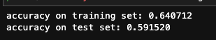
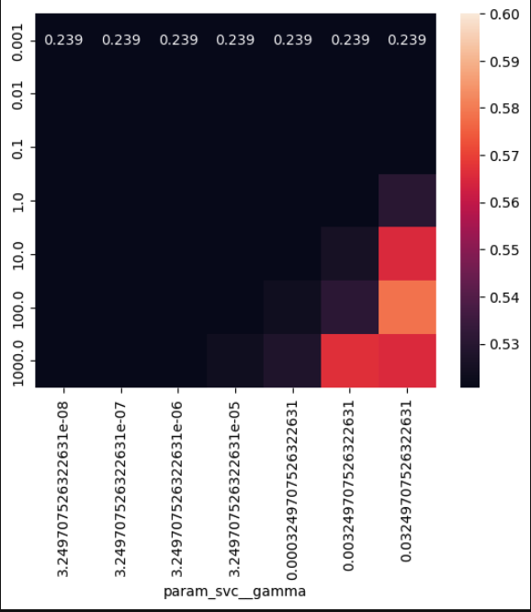
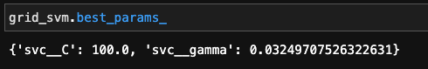
Kernelized SVM
Accuracy Score: 0.59
Best parameters
C: 100
Gamma: 0.032

Slide 37
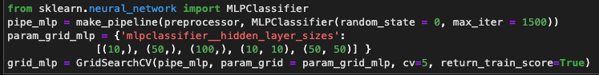
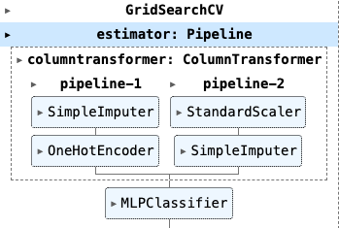
MLP Classifier
Pipeline: Use the same preprocessor
Do GridsearchCV to choose the best hidden layer size

Slide 38


MLP Classifier
Accuracy Score: 0.714
The best accuracy is when hidden layer size: (10,)
Similar to Decision Tree

Slide 39

Summary
Random Forest: 0.771
Gradient Boosting: 0.766
MLP CLassifier: 0.7137
Decision Tree: 0.7128
Logistic Regression: 0.700
Kernelized SVM 0.5915

Slide 40


Thumbnail-based Approach
CNN Model Implement on Image Datasets
Transform the image to np.array
The shape of dataset which is X:
(34192 , 128 , 128 , 3)

Slide 41
Thumbnail-based Approach
Convert the target labels (y) into the one-hot format
[1,0,0,0,0] => viewCount group 1
[0,1,0,0,0] => viewCount group 2
[0,0,1,0,0] => viewCount group 3
[0,0,0,1,0] => viewCount group 4
[0,0,0,0,1] => viewCount group 5
Train Test split by 9:1 and normalize the X_tain and X_test in between [0,1]
X_train,X_test = X_train/255.0,X_test/255.0

Slide 42


Thumbnail-based Approach
Referenced by:
HUNG-YI LEE
Professor of the Department of Electrical Engineering
of National Taiwan University
Filters

Slide 43


Thumbnail-based Approach
Referenced by:
HUNG-YI LEE
Professor of the Department of Electrical Engineering
of National Taiwan University

Slide 44

Thumbnail-based Approach
Model Structure of CNN:
Filters size is 3 x 3 for Conv1 and Conv2
Conv1 has 32 filters Conv2 has 64 filters
After Conv-Max pooling, 2 fully connected layers
Softmax with 5 group for the output

Slide 45


Thumbnail-based Approach
Output:

Slide 46


Thumbnail-based Approach
CNN Model Implement With Image Augmentation

Slide 47


Thumbnail-based Approach
Output:

Slide 48

Text-based Approach
RNN Model Implement on Text Datasets
X: the Video Title + Description
Y: 5 different group of view count

Slide 49
Text-based Approach
Tokenization and Data Clean
Tokenization: the process of breaking down text into individual words or subwords, enabling analysis and processing at a granular level.
Clean the stop word by nltk package
Example of first instance from training

Slide 50

Text-based Approach
Tokenization and Data Clean
The text length has high variety
Mean(num_tokens) + 2 * Std(num_tokens) = 520
The text has less than 520 tokens is about 93% of whole data

Slide 51


Text-based Approach
Padding
One of the instance has less than 520 tokens
The input of
X_train : (30772, 520)
X_test : (3420, 520)
Also split train test as 9:1

Slide 52



Text-based Approach
Referenced by:
HUNG-YI LEE
Professor of the Department of Electrical Engineering
of National Taiwan University
For this study, using 512 dim

Slide 53


Text-based Approach
Referenced by:
HUNG-YI LEE
Professor of the Department of Electrical Engineering
of National Taiwan University
Simple RNN

Slide 54


Text-based Approach
Model Structure of LSTM and GRU:
GRU has less param need to be trained
GRU is less complex than LSTM

Slide 55


Text-based Approach
Model Structure of LSTM and GRU:

Slide 56


Text-based Approach
Model Structure of
Bi-direction GRU &
Multihead-attention
GRU

Slide 57



Text-based Approach
Referenced by:
HUNG-YI LEE
Professor of the Department of Electrical Engineering
of National Taiwan University
Attention on RNN

Slide 58


Text-based Approach
Bi-direction GRU & Multihead-Attention GRU

Slide 59
Text-based Approach
Report of Every Model in Approach 1 and 2
 | CNN | CNN AUG | LSTM | GRU | Bidir GRU | Ats GRU
TEST SCORE | 0.47398 | 0.44064 | 0.51842 | 0.54152 | 0.55088 | 0.54649

Slide 60






Text-based Approach
CNN
LSTM
Bidir GRU
CNN AUG
GRU
Ats GRU

